Slide 1
Presentation
Jiayu Chen
2024.03.11

Slide 2
Work Description
Part_1: Template-based IBI Prediction
Part_2: BP-related Features of PPG

Slide 3
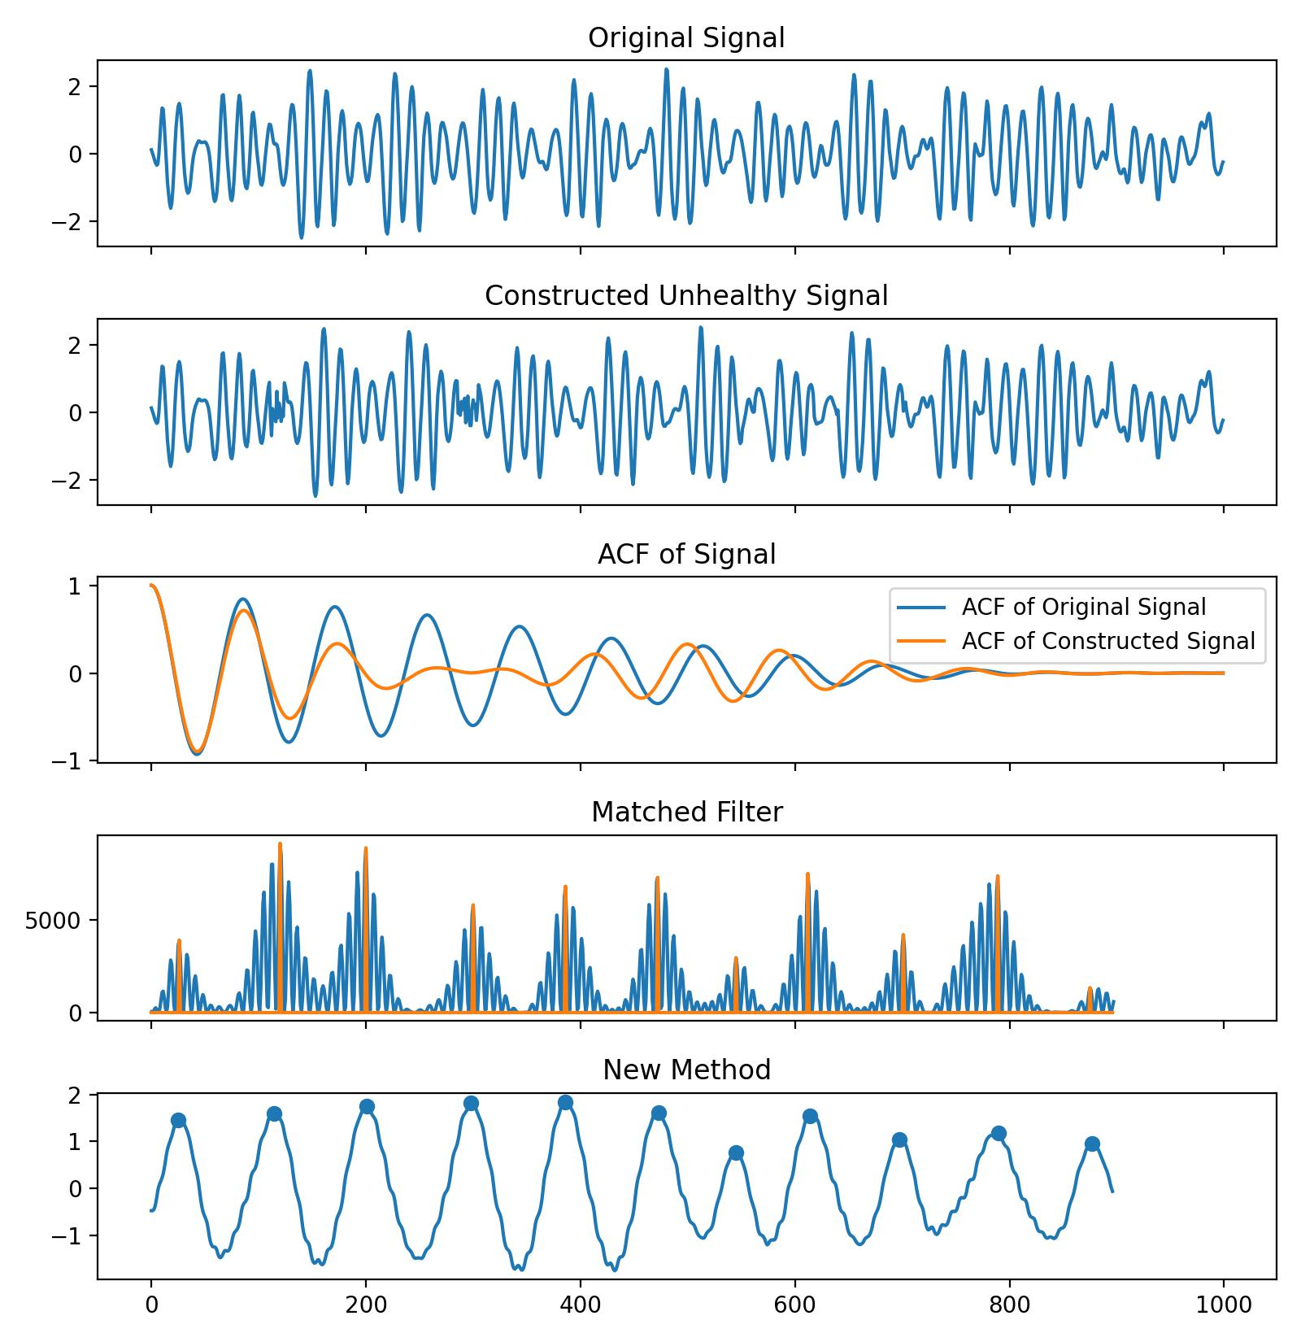
Template-based IBI Prediction
Conclusion:
The template-based approach is an effective tool for analyzing arrhythmia, advancing beyond models based on the assumption of the uniform heartbeat distribution.
Currently, a series of experiments have demonstrated its effectiveness. I believe that once the remaining issue is resolved, we can start writing the paper.
The ACF is dependent on the assumption of the uniform heartbeat distribution.

Slide 4
Template-based IBI Prediction
Experiment 1: HR Estimation
HR Estimation, MAE | Yingjian | New Method | Ratio
All_Back | 1.115 | 1.021 | -9.4%
CTRU_all_data_all_labels, Posture=0 | 1.984 | 2.000 | +0.8%
The dataset all_back is a well-filtered subset.
However, CTRU_all_data_all_labels is filtered using Yingjian's quality control method instead of more specifical methods, so the performance of New Method could be further improved in the future.
Conclusion of Experiment 1：
For high-quality data, the new method performs better. For normal quality data, the new method doesn't perform worse than the old method.

Slide 5
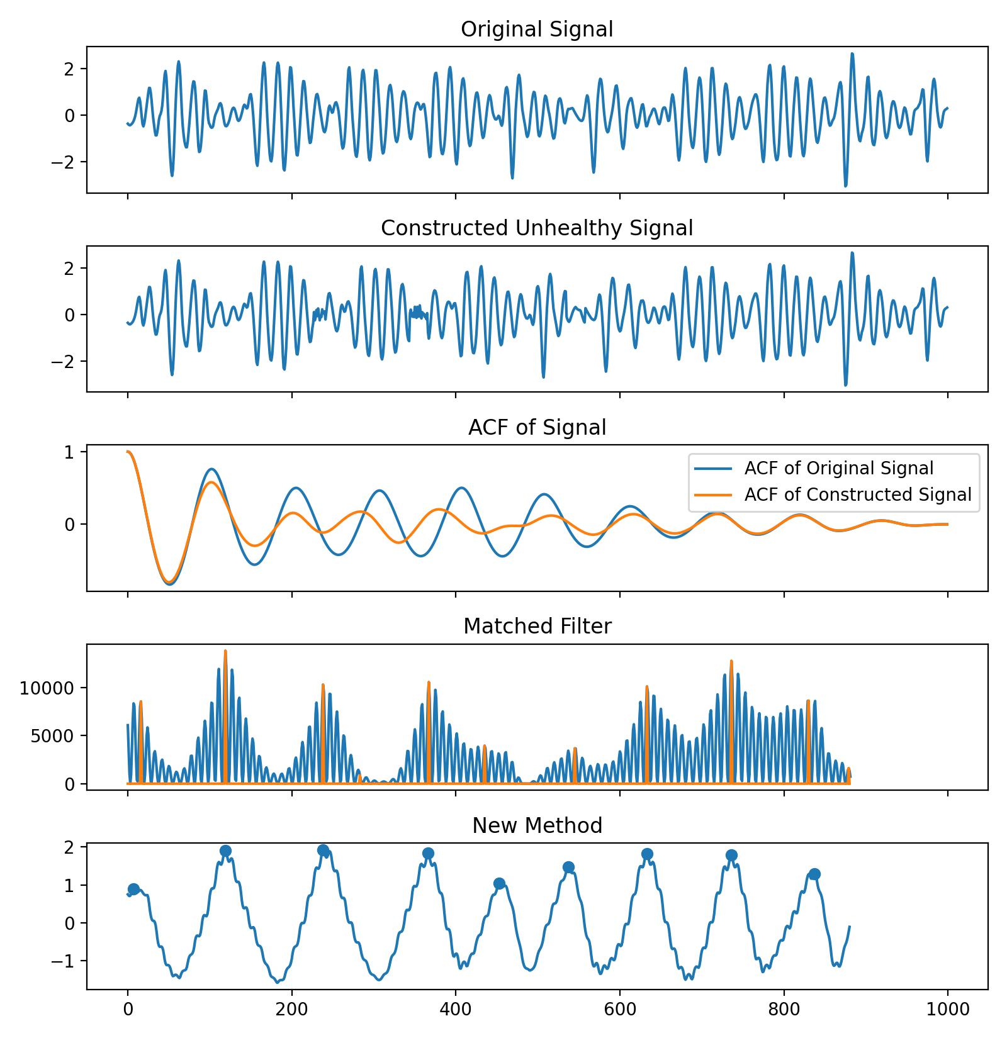
Template-based IBI Prediction
Experiment 2: Arrhythmia Classification
Confusion Matrix | Normal | Abnormal
Normal | 548 (17.31%) | 95 (3.00%)
Abnormal | 3 (0.1%) | 2519 (79.59%)
A 10-second BSG signal can construct a dataset of heart rate anomalies while ensuring a constant heart rate.
Conclusion of Experiment 2：
The new version method is more robust compared to the matched filter-based method, enabling effective classification of arrhythmic data.

Slide 6
Template-based IBI Prediction
Experiment 3
HR Estimation, MAE | Yingjian | New Method | Ratio
All Back(all) | 1.115 | 1.021 | -9.4%
All Back(healthy) | 1.034 | 0.970 | -6.4%
All Back(arrhythmia) | 1.851 | 2.083 | -
Using the classification algo from Experiment 2, the dataset was divided into 2 parts: normal heart rate signals and signals classified as abnormal heart rates.
The New Method performs better on healthy signals. Further explanation will be provided regarding results on arrhythmia data.

Slide 7
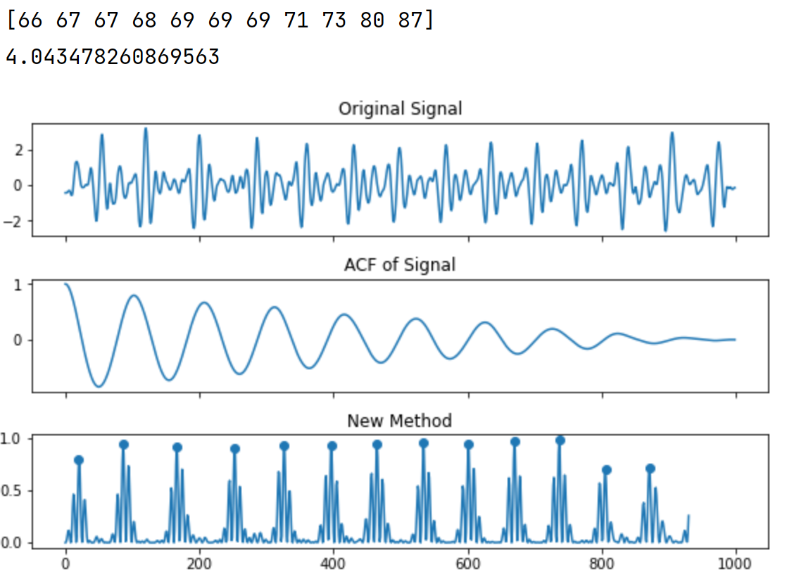
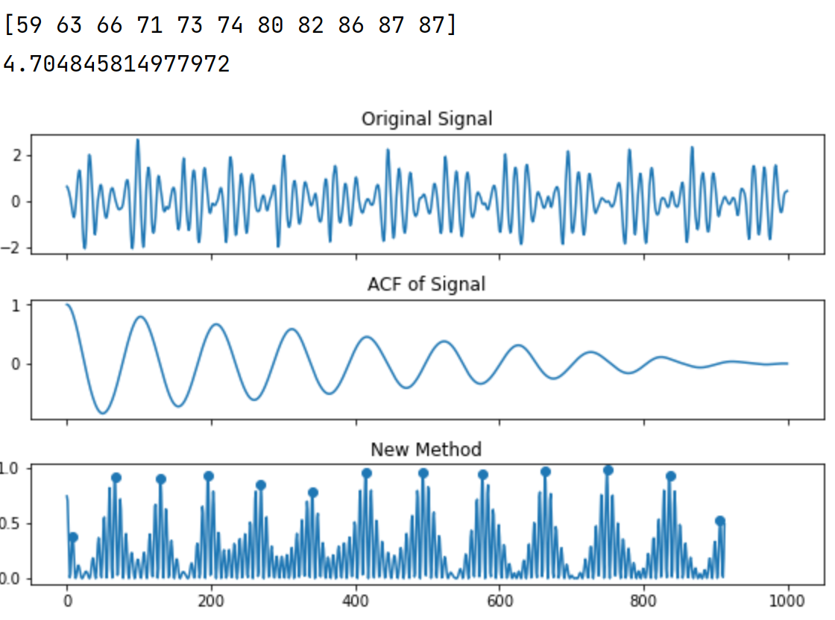
Template-based IBI Prediction
IBI
MAE of HR
On arrhythmic data, heartbeats are well detected, but the MAE of HR is quite large.
HR_estimated = 60*sampling_rate/median(IBIs)
Healthy
Method 1
Classification
HR
Arrhythmia
Method 2
IBI
MAE of HR
Conclusion of Experiment 3：
The new method performs better on healthy signals and accurately detects IBI on arrhythmic data. But we need another hr estimation algo for arrhythmic signals.

Slide 8
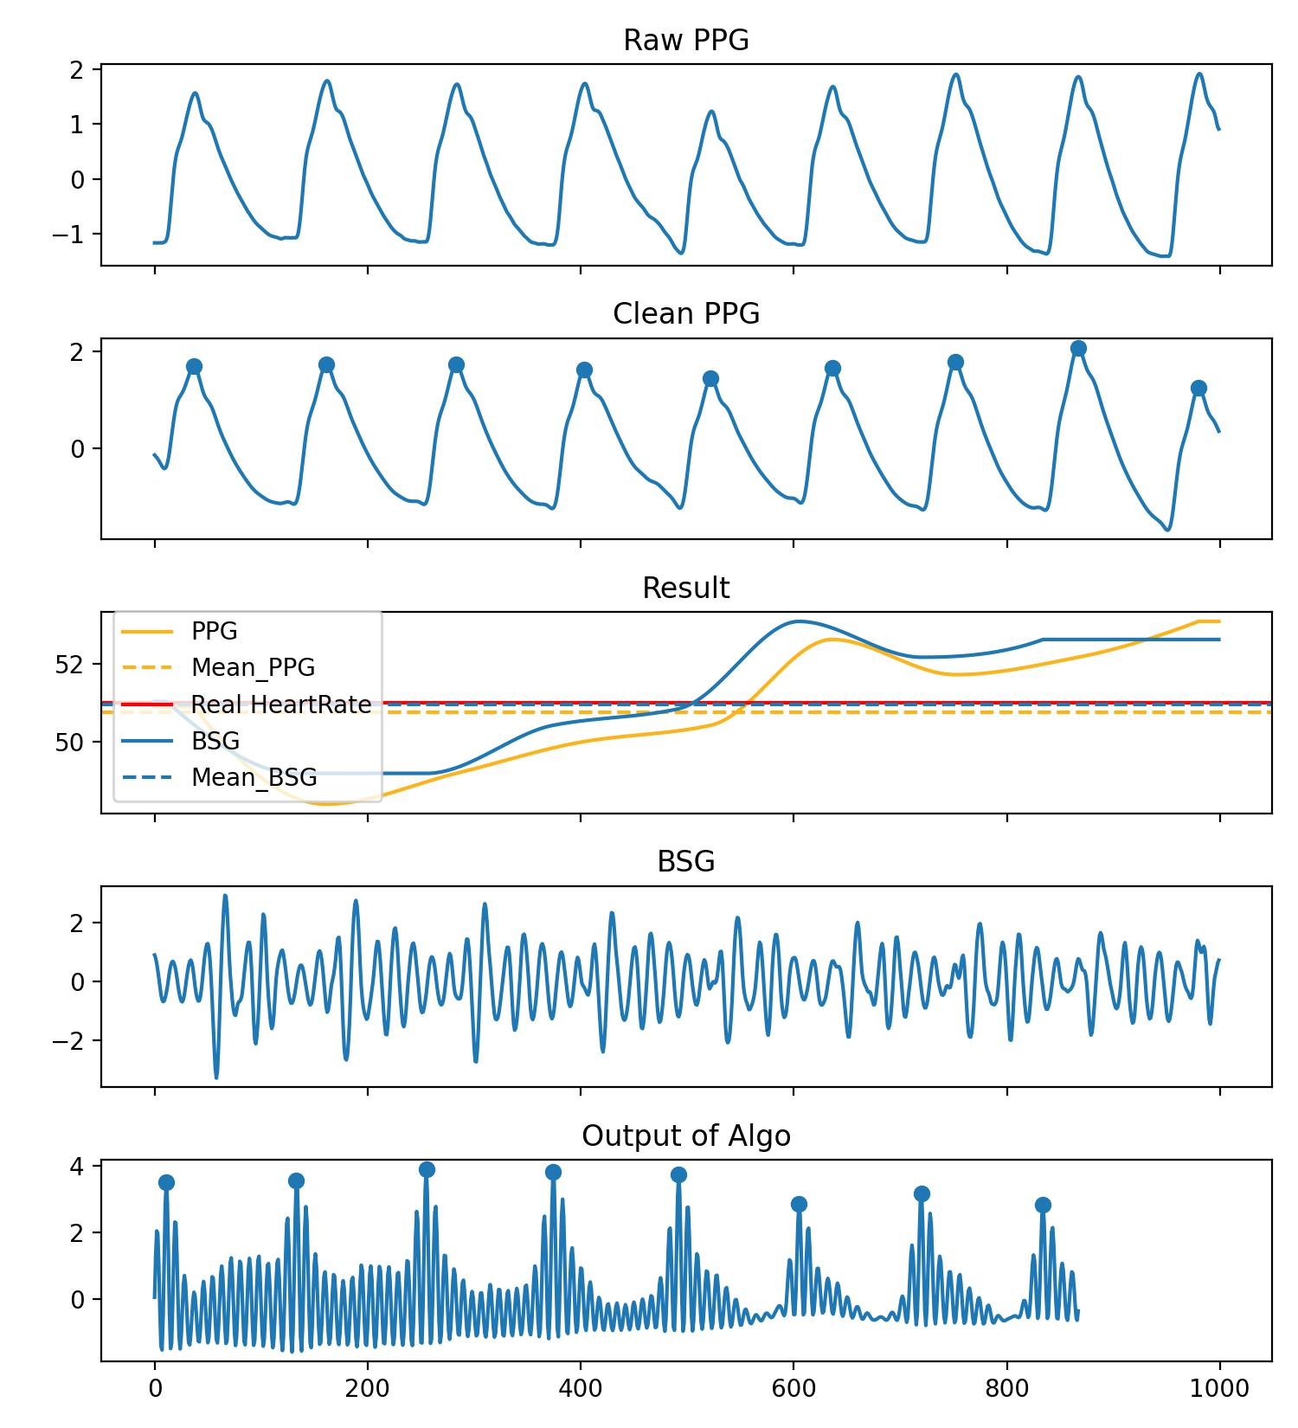
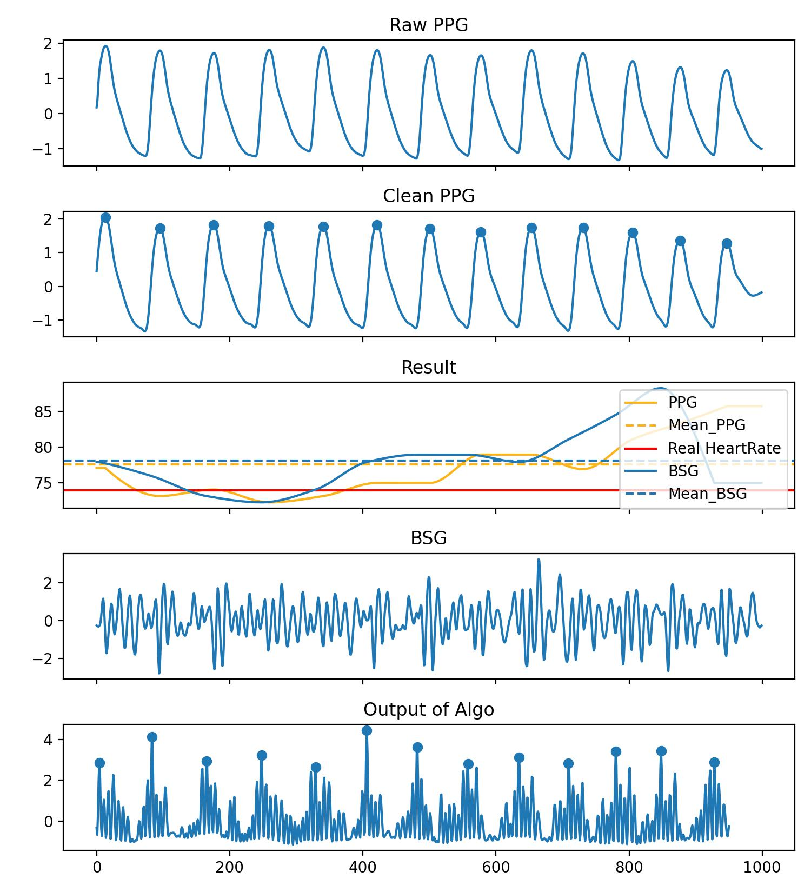
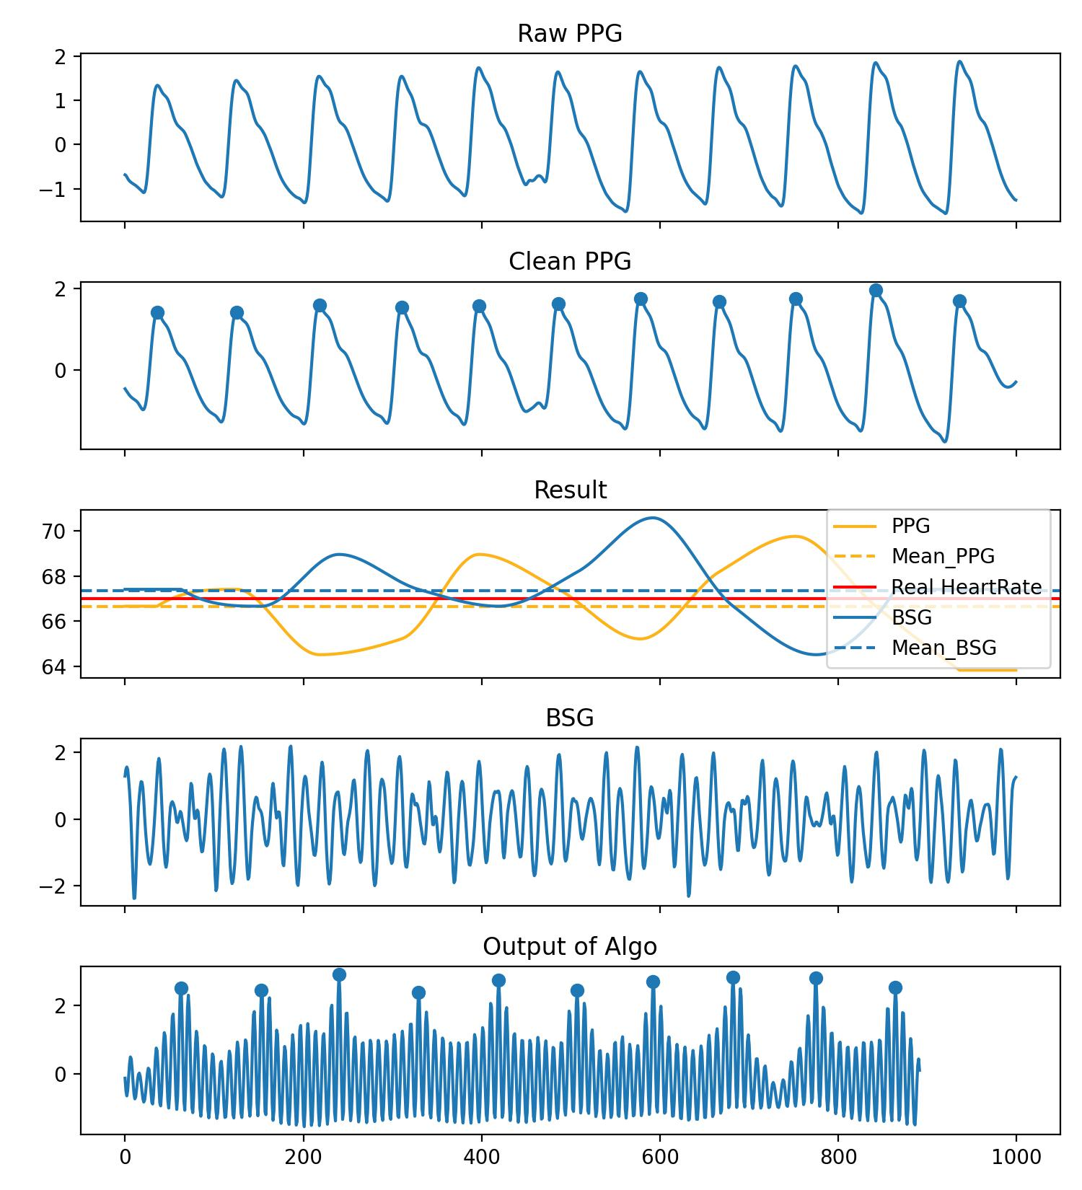
Template-based IBI Prediction
Experiment 4: IBI Prediction
The IBI calculated from PPG and BSG signals does not strictly correspond, so currently, visualization is used to display the results. The results mainly consist of 4 categories.
Category 1: The trends are consistent.

Slide 9
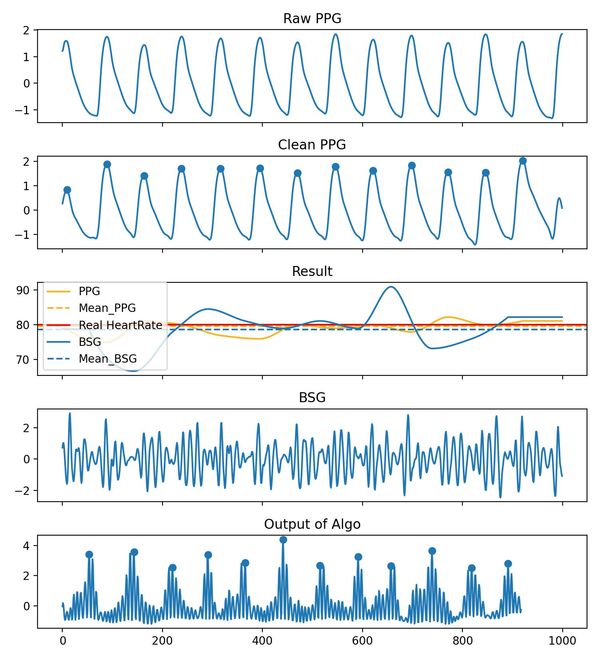
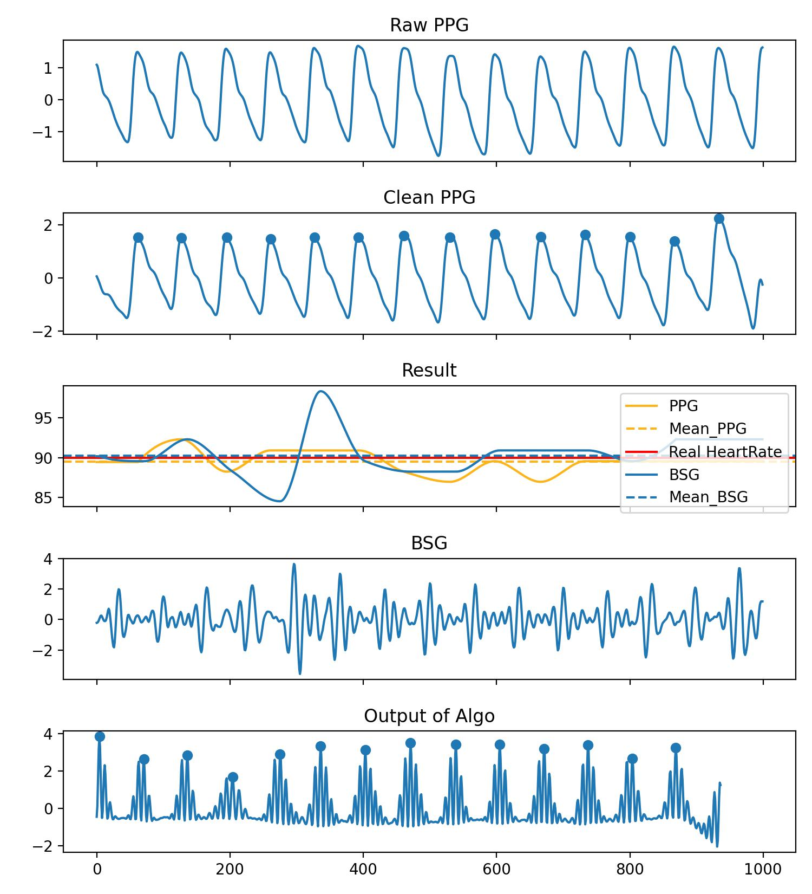
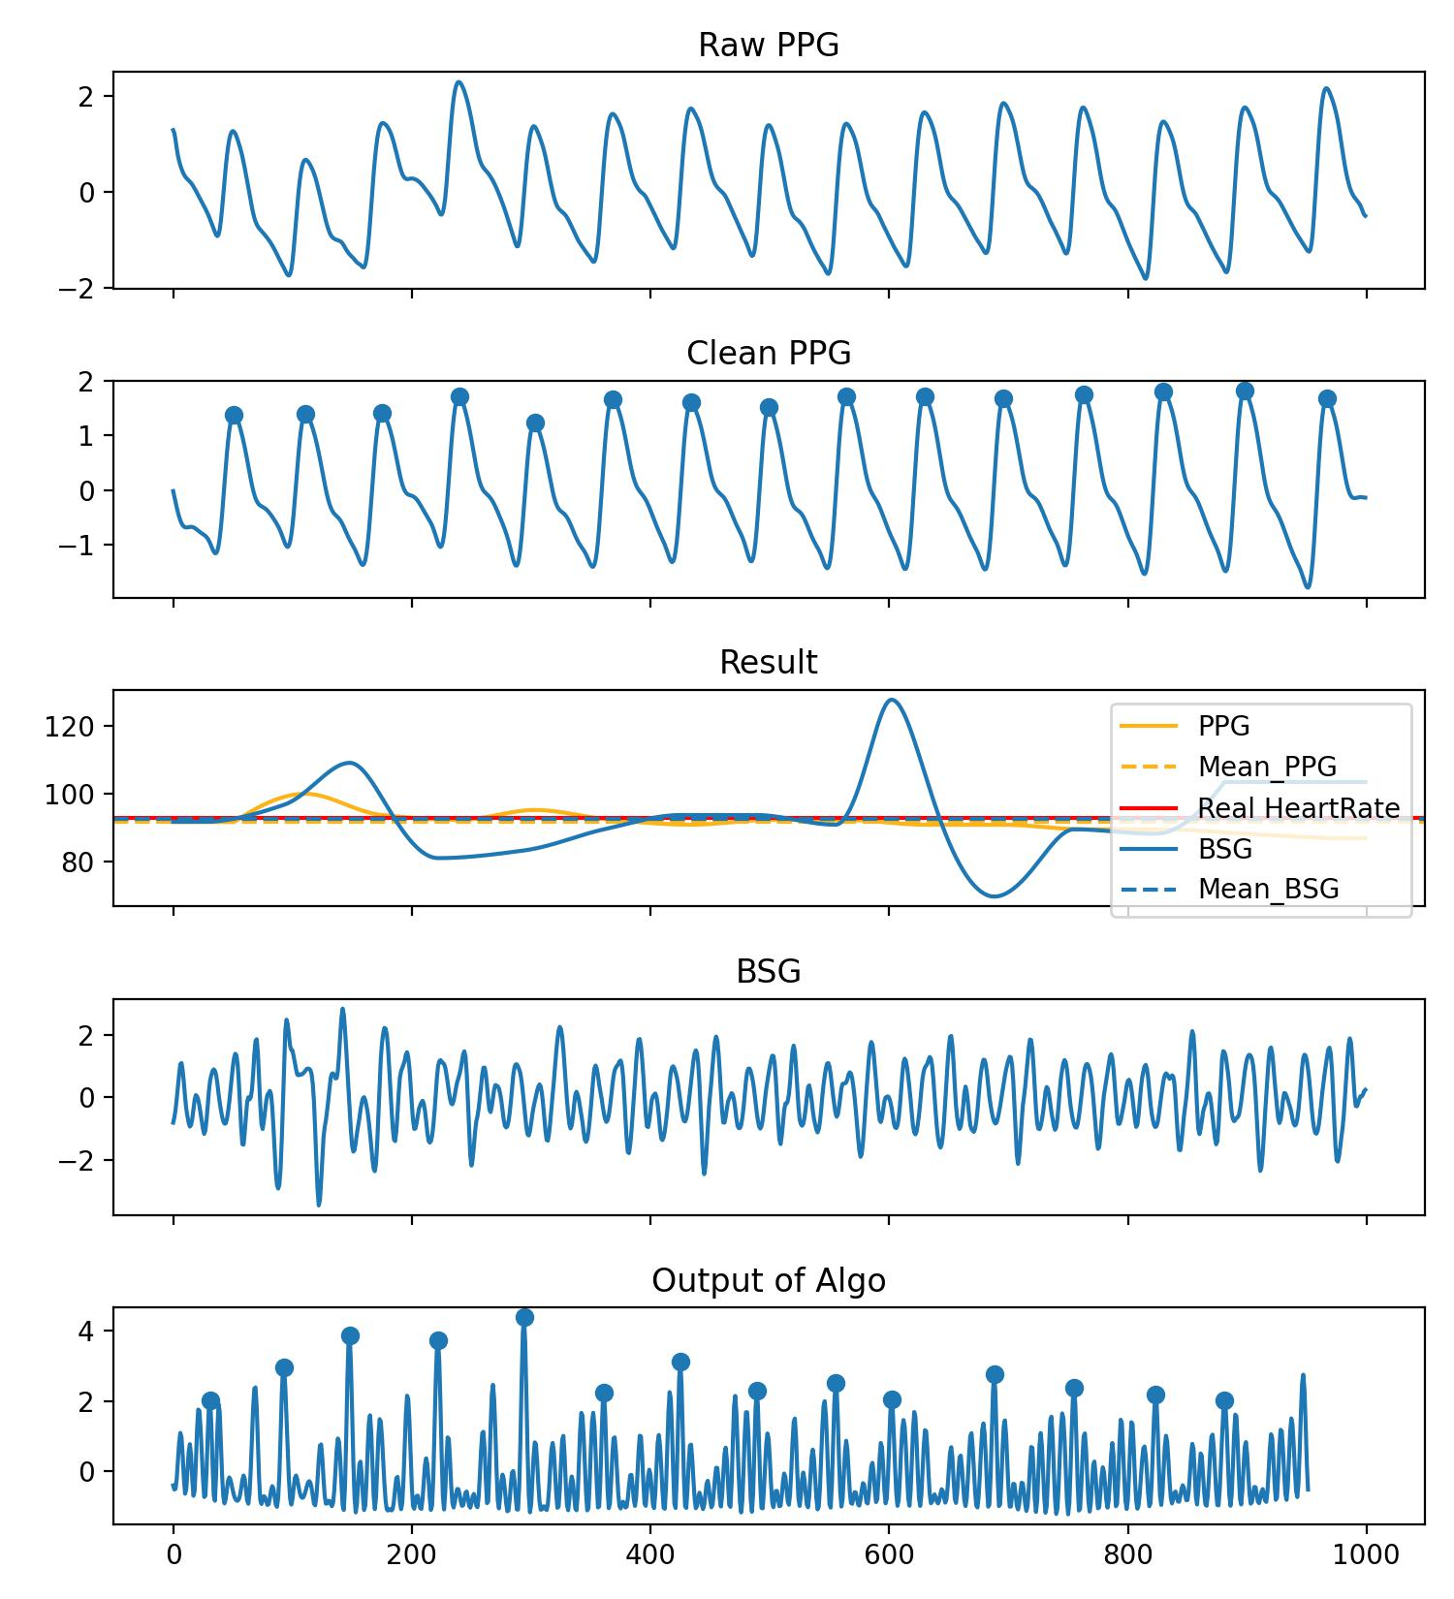
Template-based IBI Prediction
Category 2: The trend doesn't match, but estimated heart rate error is quite small.

Slide 10
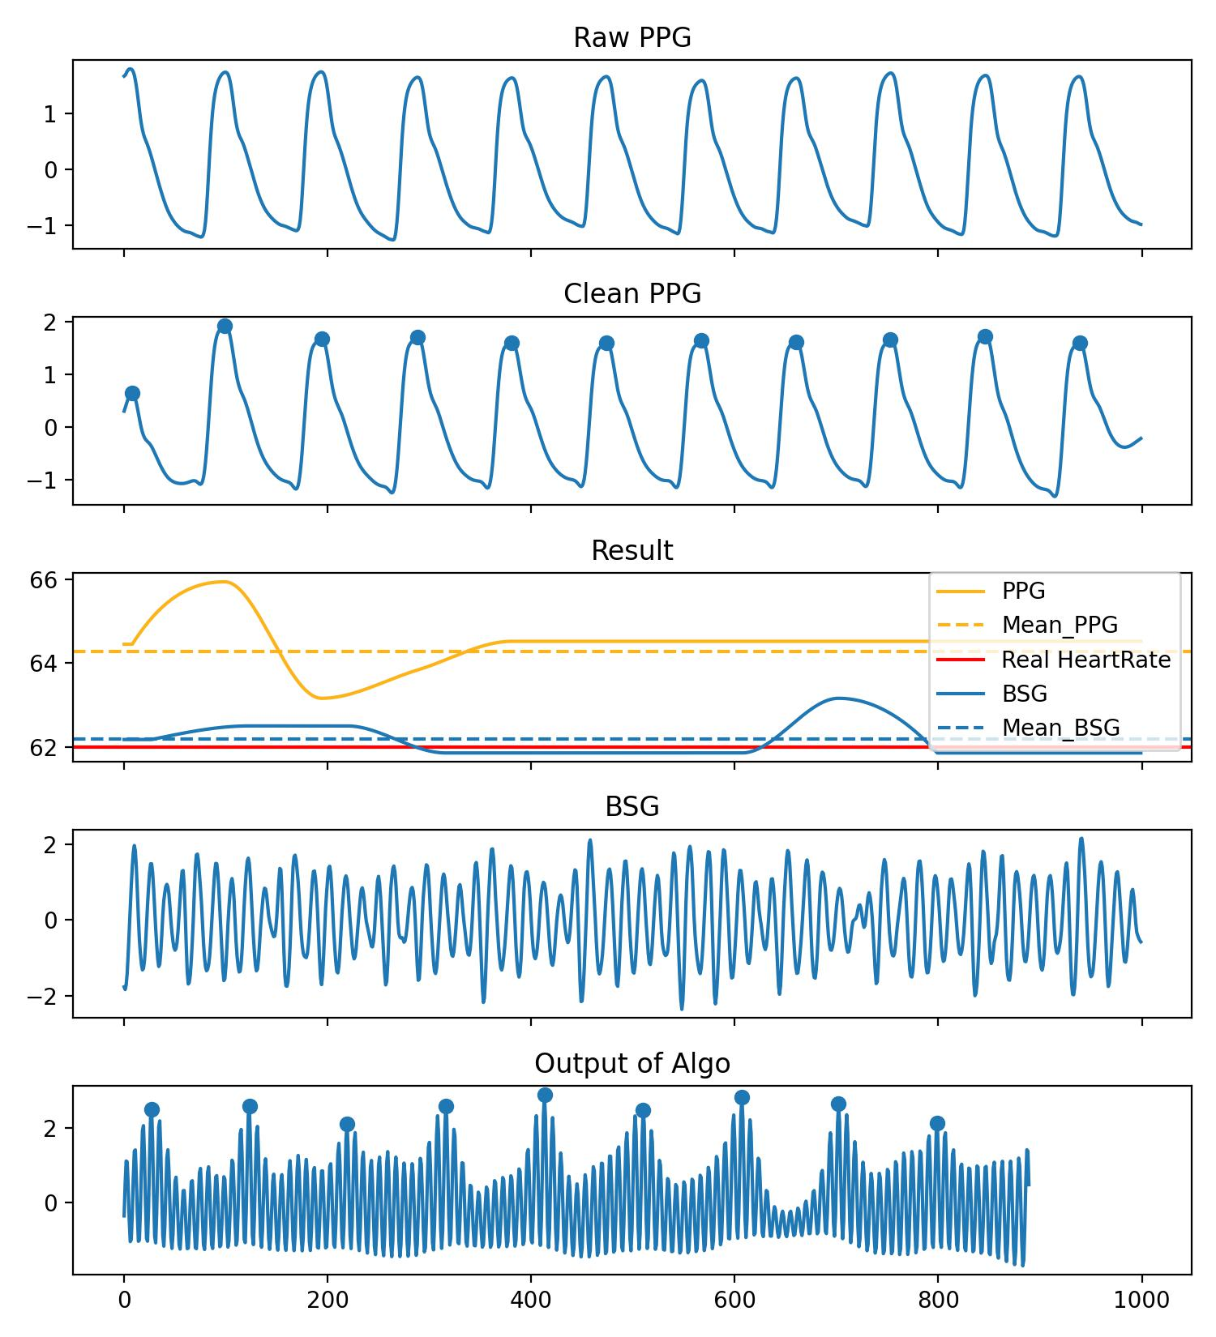
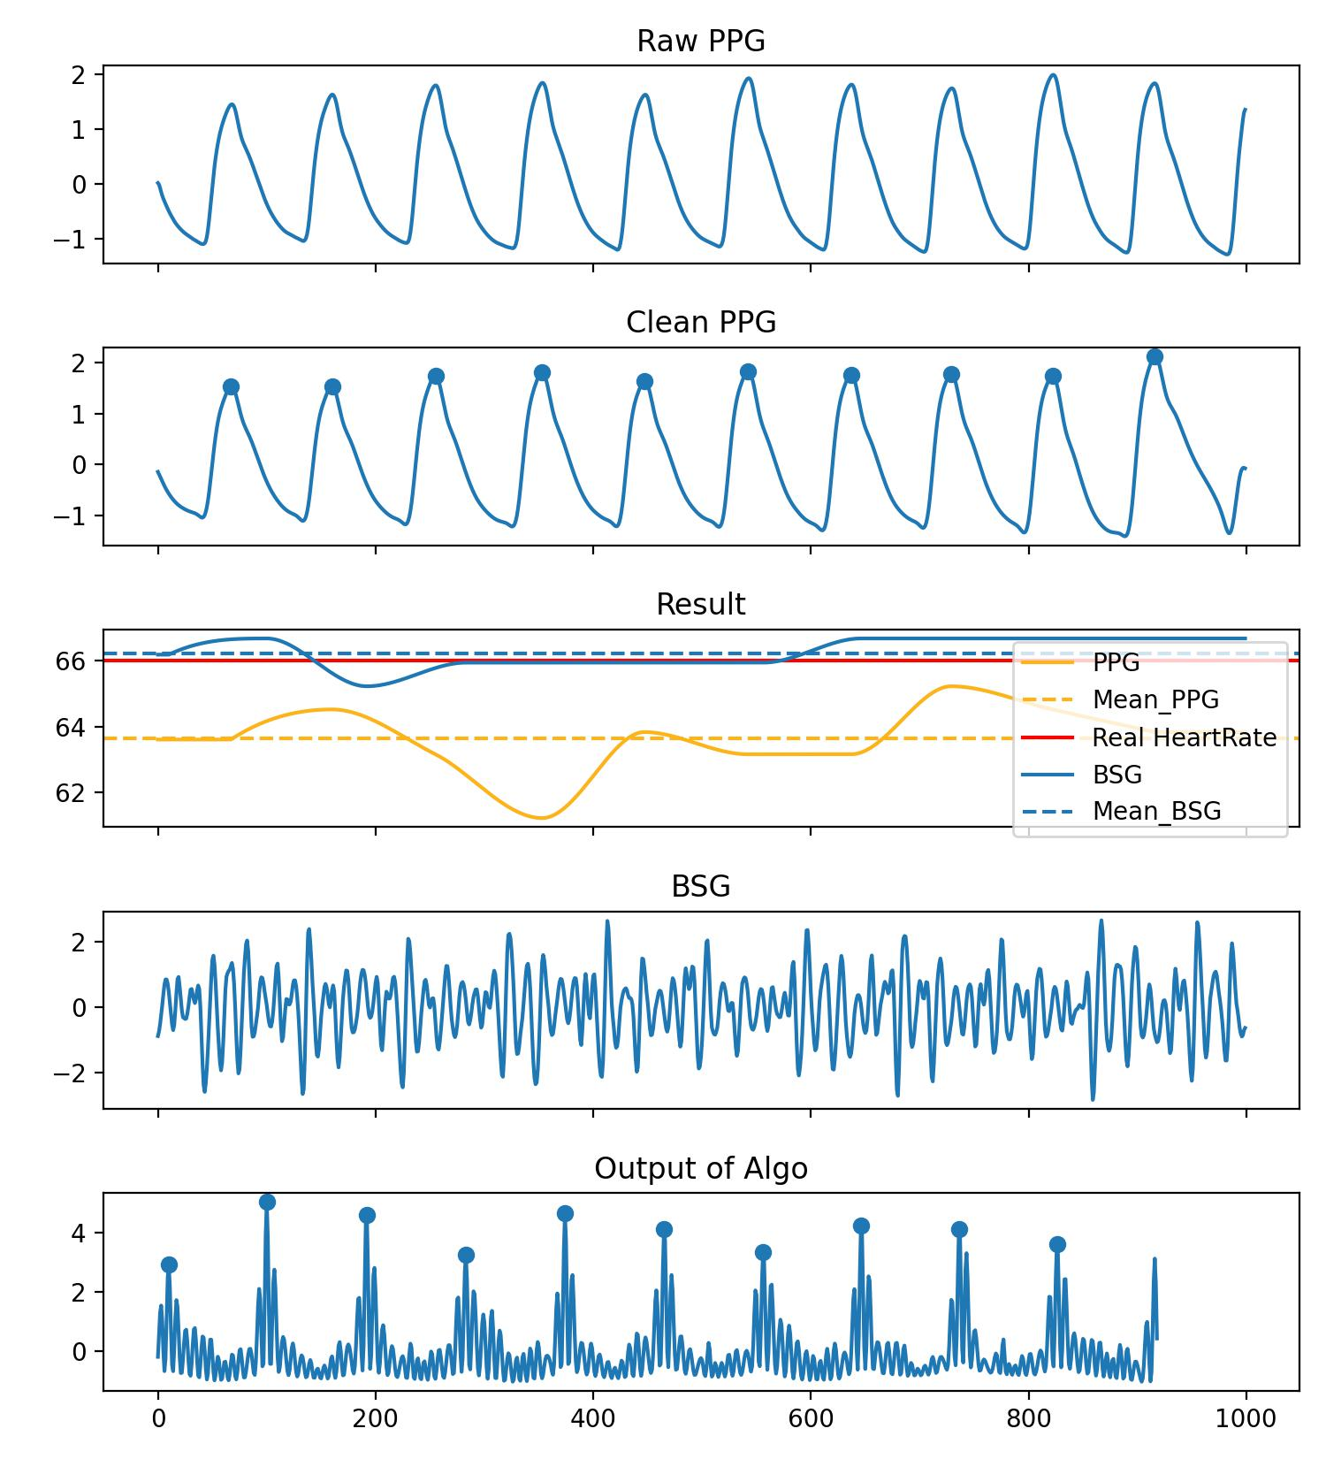
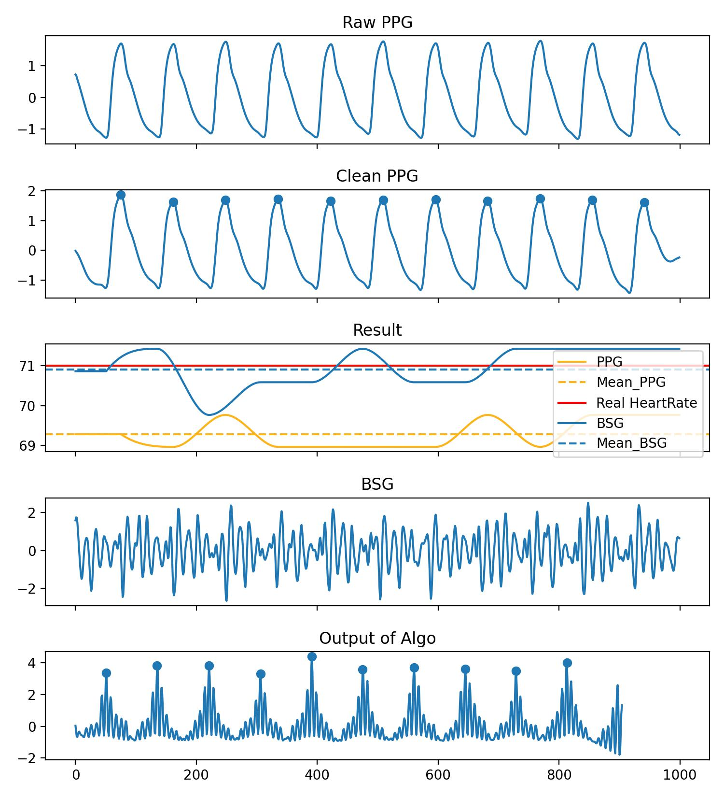
Template-based IBI Prediction
Category 3: It seems that the error in PPG is larger.

Slide 11
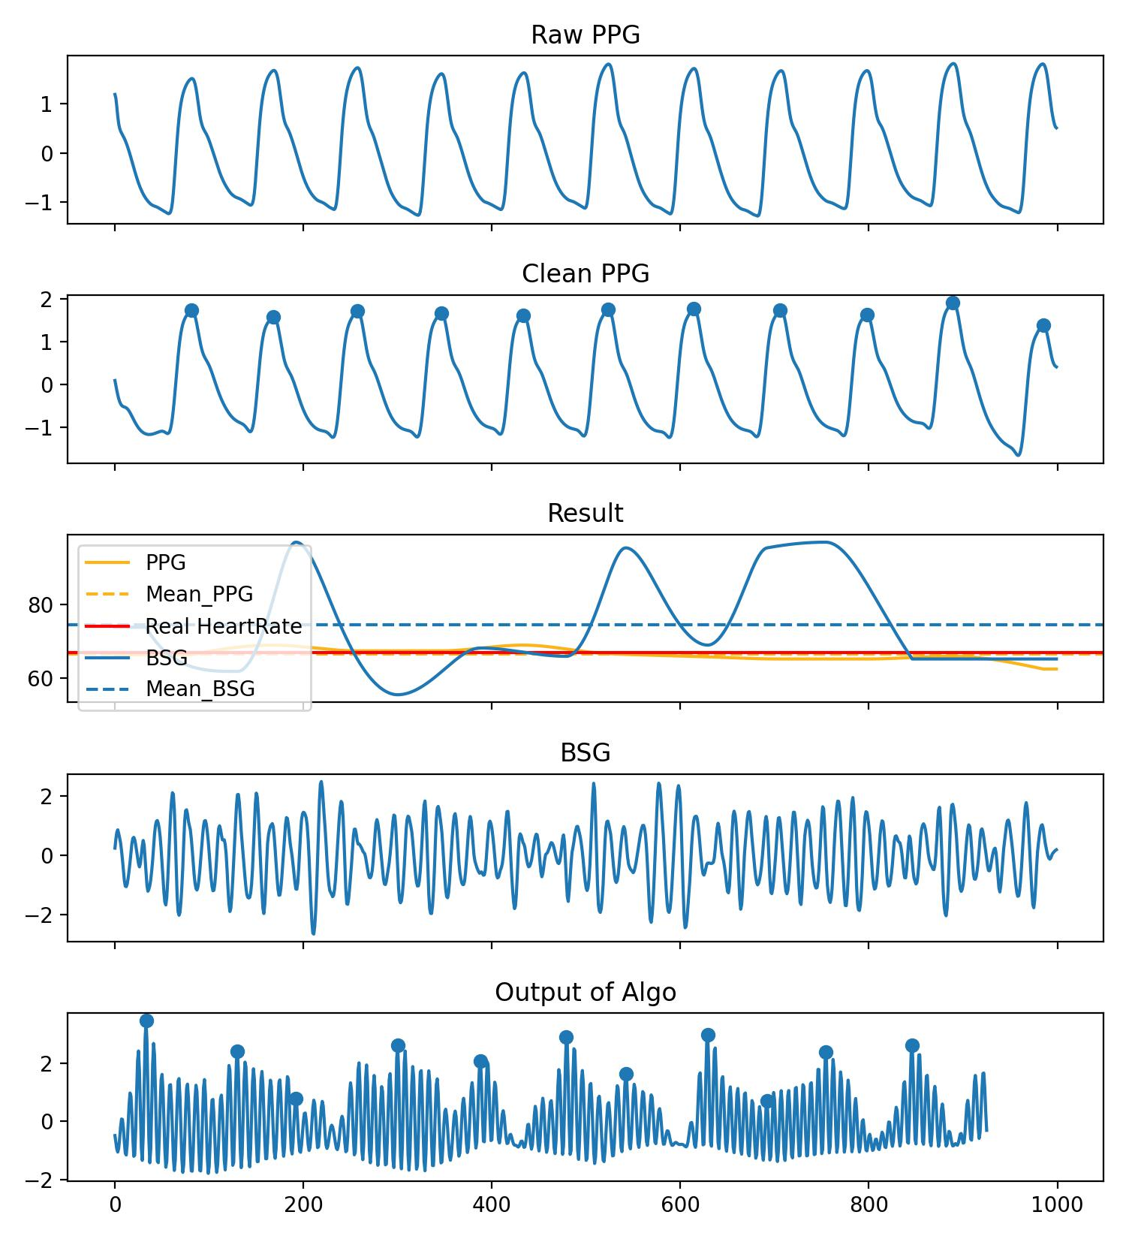
Template-based IBI Prediction
Category 4: Quality control of BSG signals needs to be improved.
Conclusion of Experiment 4:
PPG is sometimes not entirely reliable, and there is a phase shift between PPG and BSG. Using IBI obtained from PPG as labels seems inappropriate.
The new method either has high accuracy or large errors.
The prediction of HR differs from the prediction of IBI. We need stricter quality control to ensure accuracy of each heartbeat interval.

Slide 12
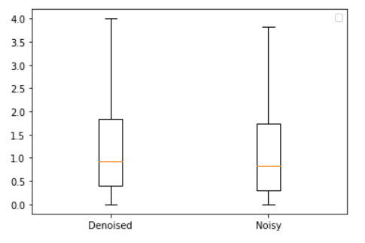
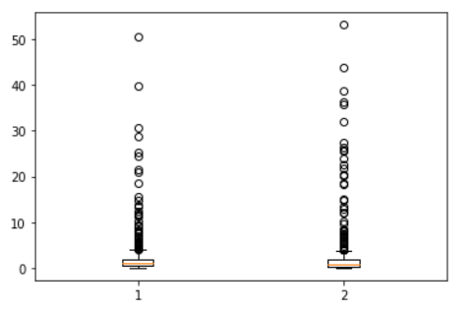
Template-based IBI Prediction
Experiment 5
Quality control is necessary, but denoising is not essential. Most noise is unrelated, and some noise can actually help us match more accurately.
MAE of HR
MAE of HR
Denoised Noisy
Denoised Noisy

Slide 13
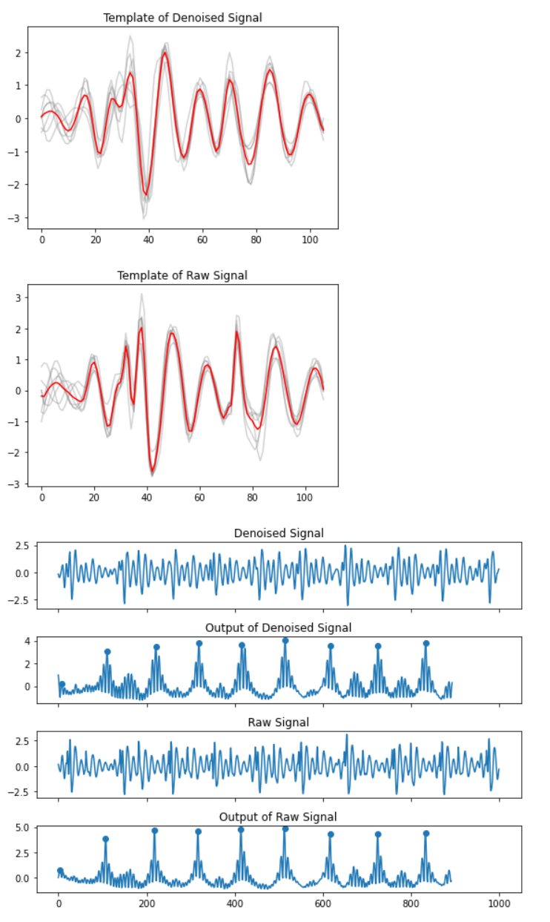
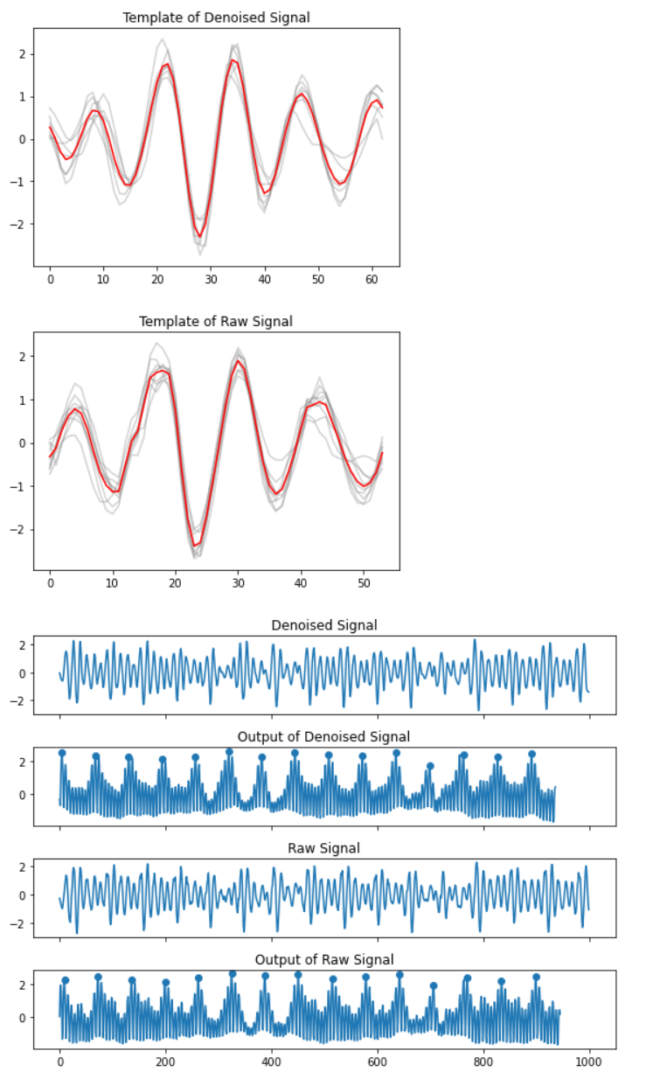
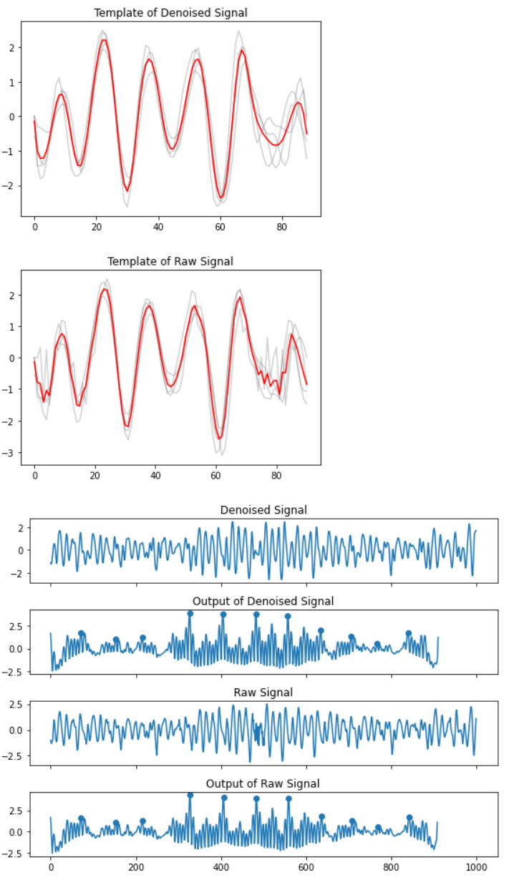
Template-based IBI Prediction

Slide 14
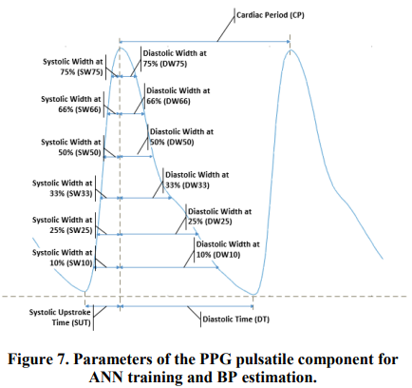
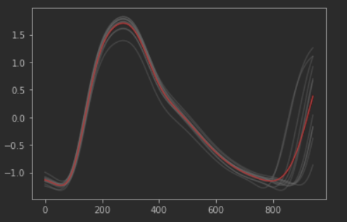
BP-related Features of PPG
Model | S (Real/Paper) | D (Real/Paper)
LR | 15.737/12.224 | 8.495/9.204
SVR | 14.905/11.6415 | 7.869/7.617
Template-based Feature Extraction
Reference: Zhang Y, Feng Z. A SVM method for continuous blood pressure estimation from a PPG signal[C]//Proceedings of the 9th international conference on machine learning and computing. 2017: 128-132.

Slide 15
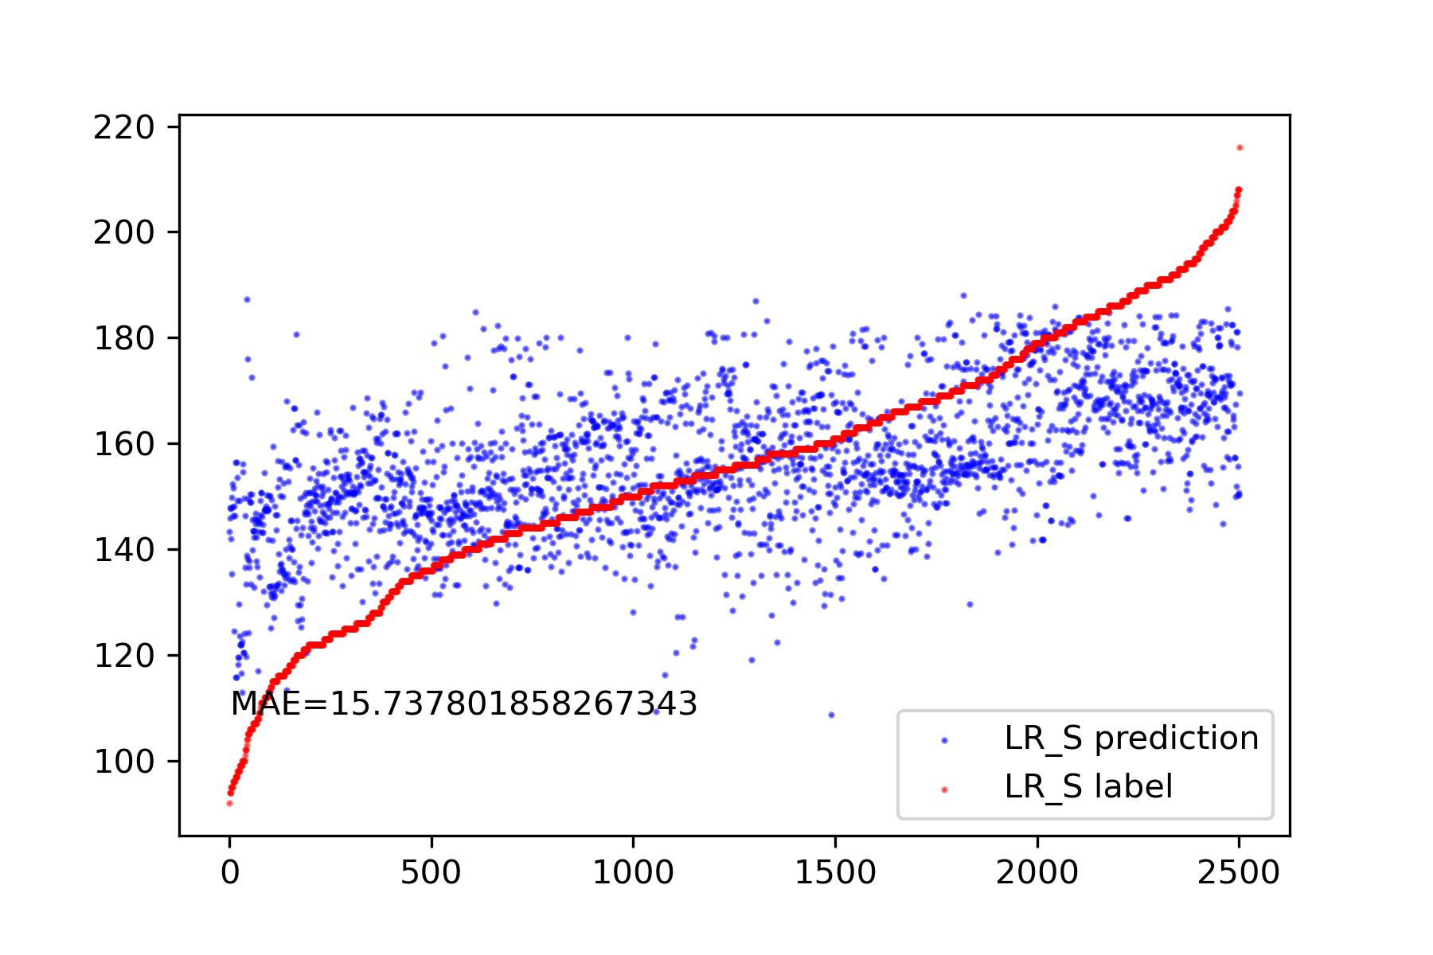
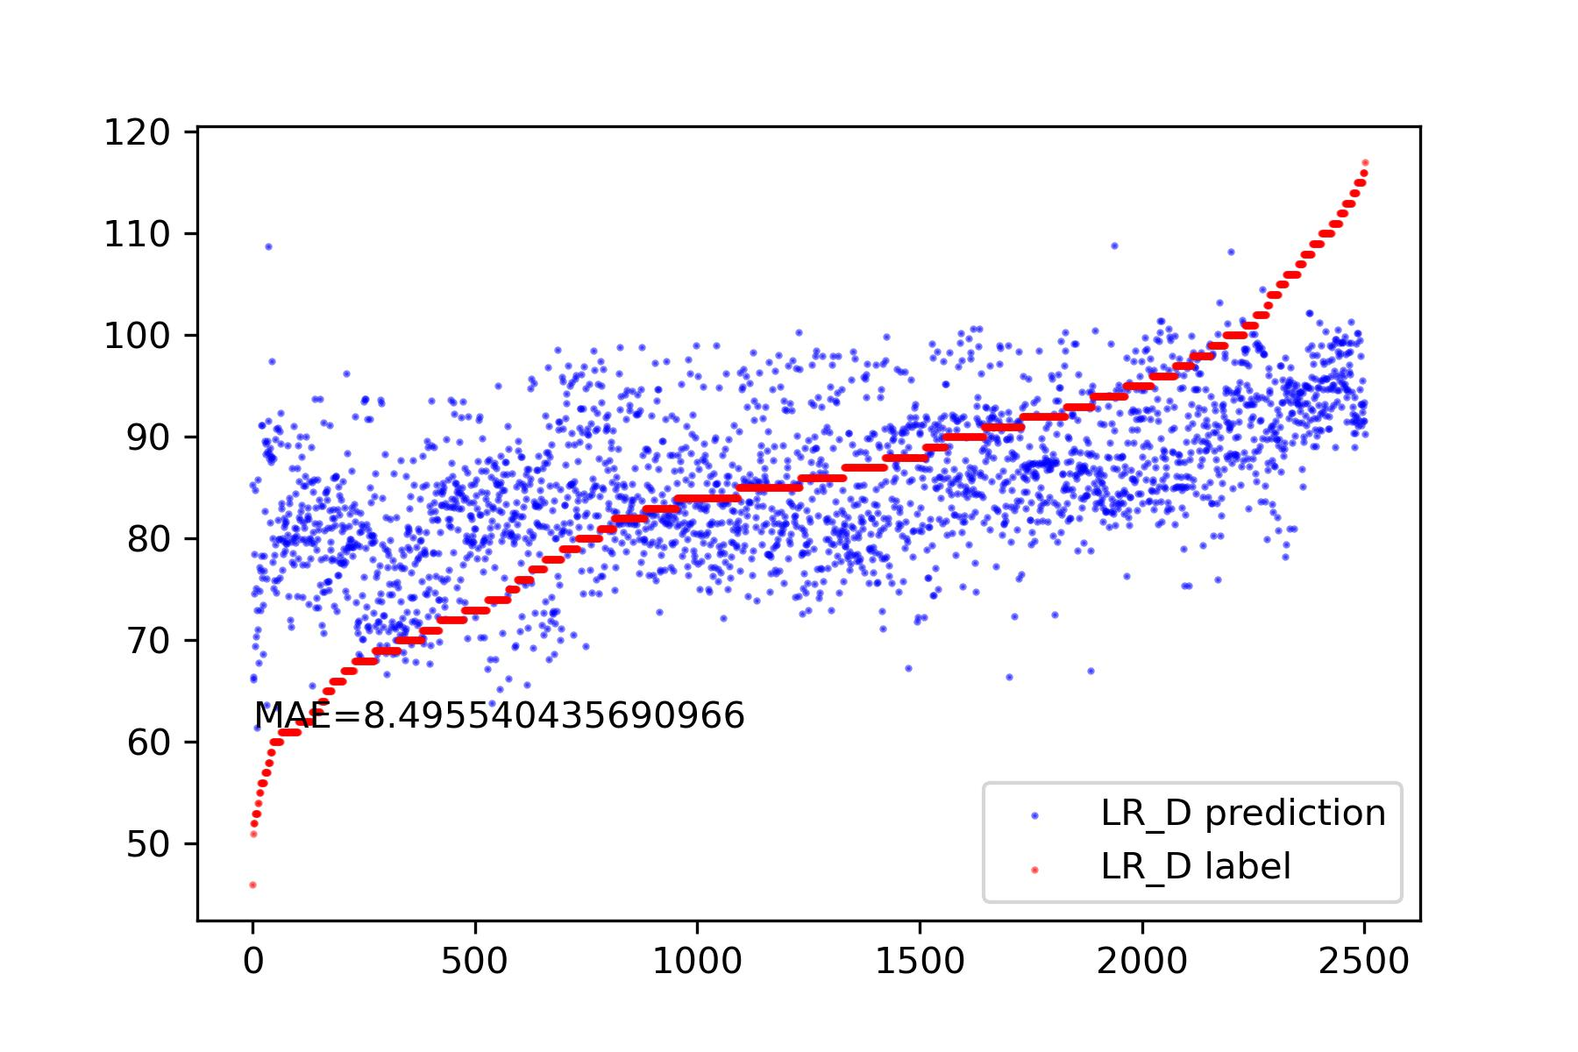
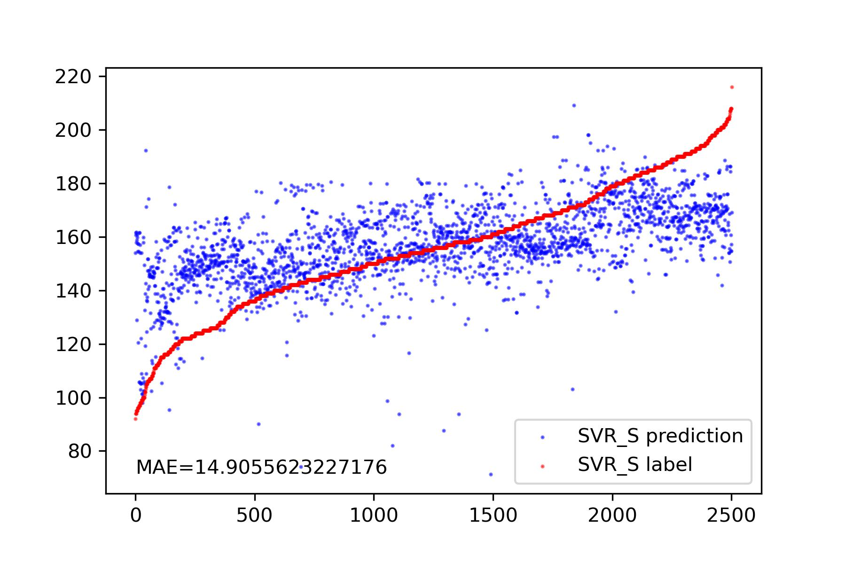
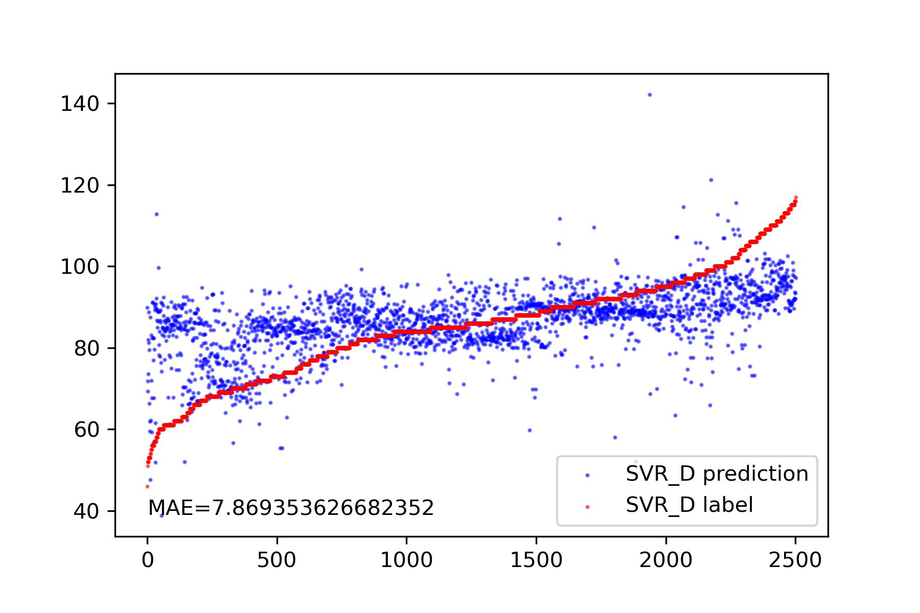
BP-related Features of PPG

Slide 16
Question
How could I get IBI label? PPG is not entirely reliable.
How should we calculate the heartrate from arrhythmic signals when we get high accurate IBI?
Have these experimental results reached the level suitable for writing a paper?

Slide 17
Thanks!

